Slide 1

Noldus System for Basic Capture
Part of a series of custom-built Alexa skills for NHI's "Lehigh Buddy" Designed by A. Harmer Programmed by Aabiskar Thapa Kshetri, Nix Huang, Diya Pandey, Shuang Lin

Slide 2
The Noldus System is a professional tool for observational research. In the NanoHuman Interfaces Initiative at Lehigh University, we use the Noldus System to observe materials scientists as they interact with newly-built 3D and AI apps that the NHI team is developing to accelerate scientists' pace of discovery.
What is the Noldus System?

Slide 3
How does the Noldus System work?
The Noldus System in Research Lab #1 of the NHI Lab is operated through two software applications. The first is Viso for capturing data in the lab and the second is Observer XT software for consequent behavioral research analysis.
To use either software you must be logged into the Noldus system.

Slide 4
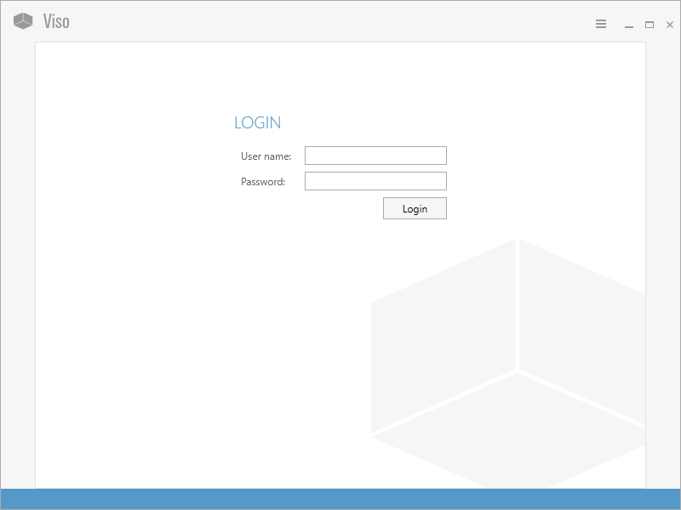
How does Viso work?
Log in to the Noldus as shown on the screen below:
Say, "Alexa, continue," for more.
Say, "Alexa, back" to go back.
p. 1/11

Slide 5
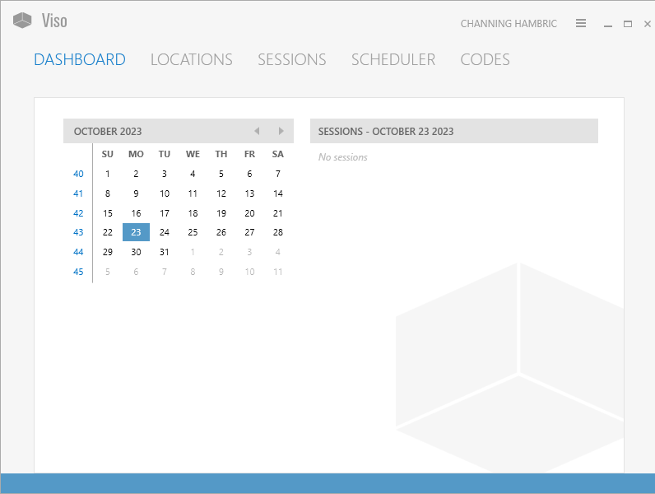
There are five options in Viso menu:
Dashboard, Locations, Sessions, Scheduler, Codes
Let's look at them individually.
Say, "Alexa, continue," for more.
Say, "Alexa, back" to go back.
p. 2/11

Slide 6
This is the Viso Dashboard, where you may view your activities. Note five options on top.
Say, "Alexa, continue," for more.
Say, "Alexa, back" to go back.
p. 3/11

Slide 7
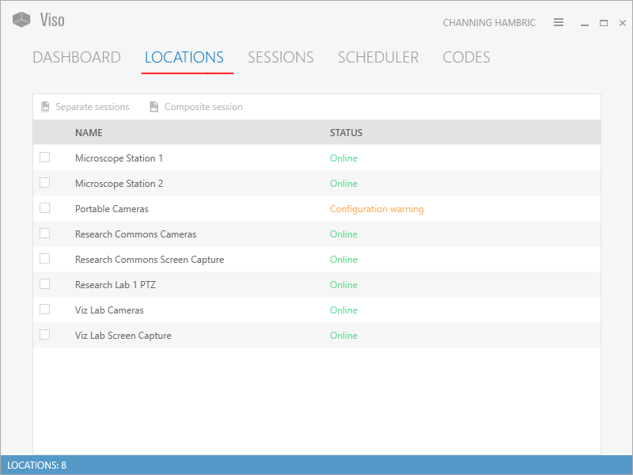
This is the Locations option where you choose the locations where you want to record.
Say, "Alexa, continue," for more.
Say, "Alexa, back" to go back.
p. 4/11

Slide 8
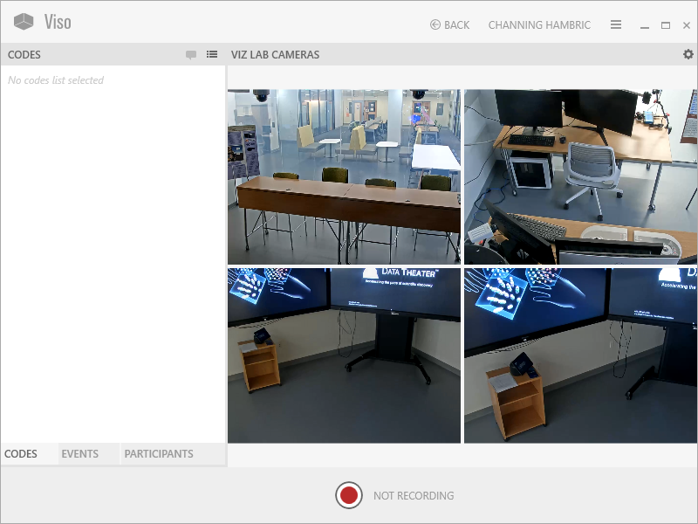
Hit the red record button on the bottom center of screen to begin recording.
Say, "Alexa, continue," for more.
Say, "Alexa, back" to go back.
p. 5/11
For example, this is what the VIZ Lab cameras will record.

Slide 9
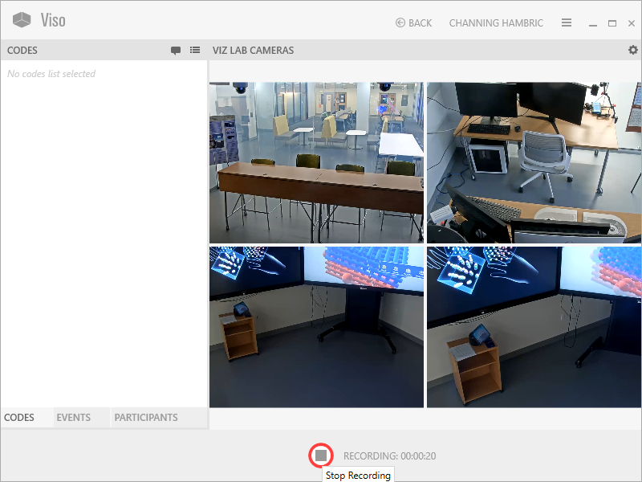
When you want to stop, hit the record button again, this will also show you the length of your video below.
Say, "Alexa, continue," for more.
Say, "Alexa, back" to go back.
p. 6/11

Slide 10
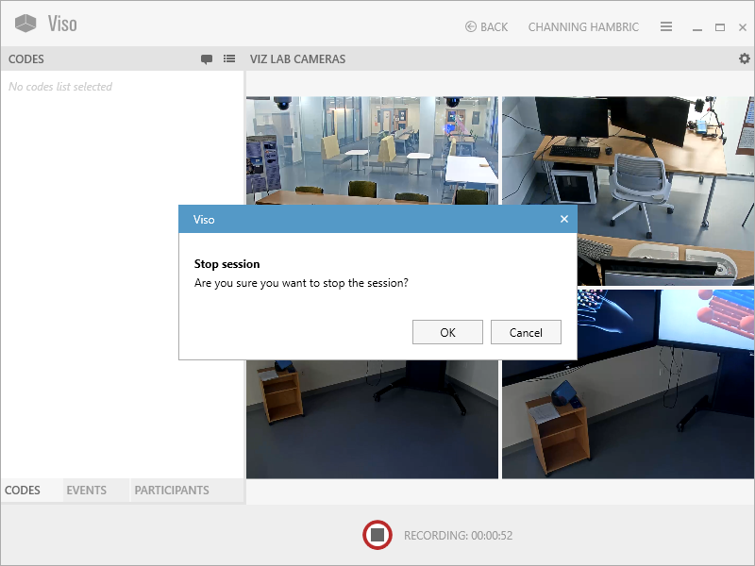
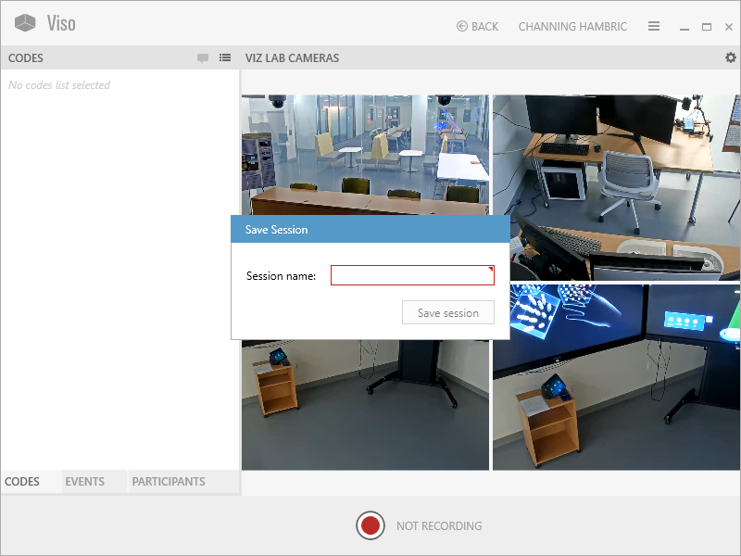
Viso will ask if you're sure you want to stop recording the session. If you respond with yes, it will ask you to "name," then "save" your session.
Say, "Alexa, continue," for more.
Say, "Alexa, back" to go back.
p. 7/11

Slide 11
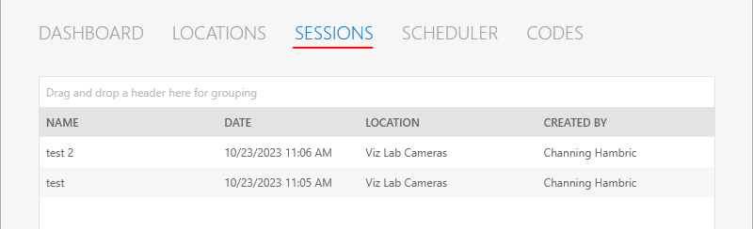
In the Sessions option, you may view all your recorded sessions.
Say, "Alexa, continue," for more.
Say, "Alexa, back" to go back.
p. 8/11

Slide 12
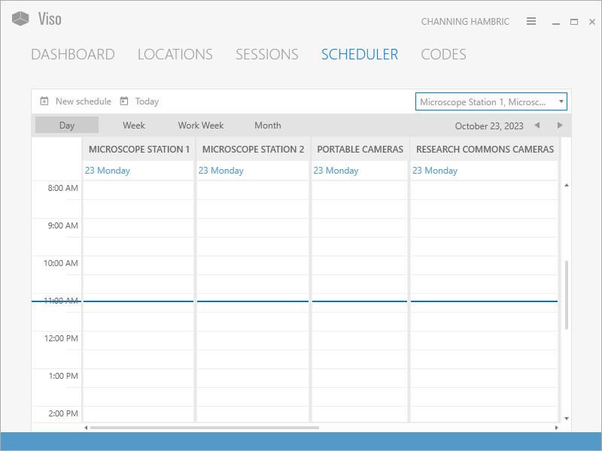
In the Scheduler option, you may schedule future sessions.
Say, "Alexa, continue," for more.
Say, "Alexa, back" to go back.
p. 9/11

Slide 13
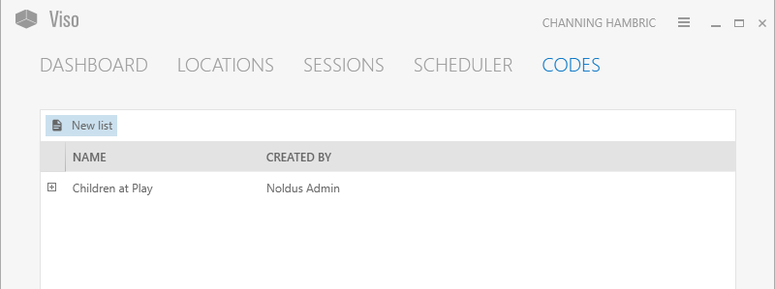
In the Codes option, you may create codes to take note of various behaviors you want to analyze later.
Say, "Alexa, continue," for more.
Say, "Alexa, back" to go back.
p.10/11

Slide 14
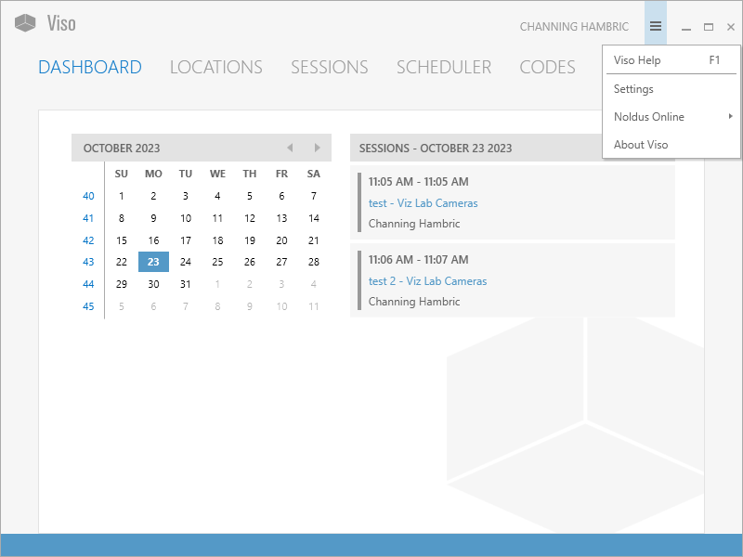
Returning to the Dashboard
Here you will see the named sessions that you have just recorded.
p. 11/11

Slide 15
There are three basic functions in the Observer XT software to assist you with your research.
How can ObserverXT assist me with my research?
Step 1: Set Up - Creating and defining your settings and coding scheme
Step 2: Observe - Acquiring and observing your data
Step 3: Analyze - Analyzing your data
Let's look at each of these Steps in more detail.

Slide 16
Observer XT allows you to timestamp events based on video and audio recordings of your observations.
How does the Observer XT software work?
You may annotate dialogue of interest and set up your coding scheme actions to note behaviors.
For example, noting scientists' interactions using innovative technologies.
Did you notice any patterns of behavior?

Slide 17
How do I get started? Step 1: Set Up
Make sure the hardware key top open ObserverXT is inserted into the computer
Go into Viso (Session window) and right click on video file you want to analyze to Export the video file to Observer XT
Choose the second option (picture by picture video) to export to ObserverXT
Note:
If you have already exported your file to ObserverXT, go directly to Observer XT and search for file previously recorded and exported.
Set Up 1/7

Slide 18
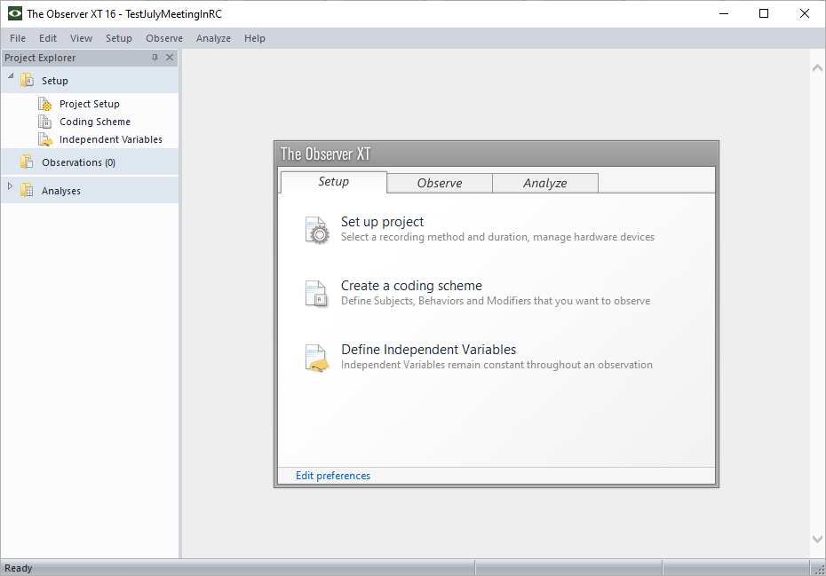
See three options in ObserverXT Main Menu
Set Up 2/7​

Slide 19
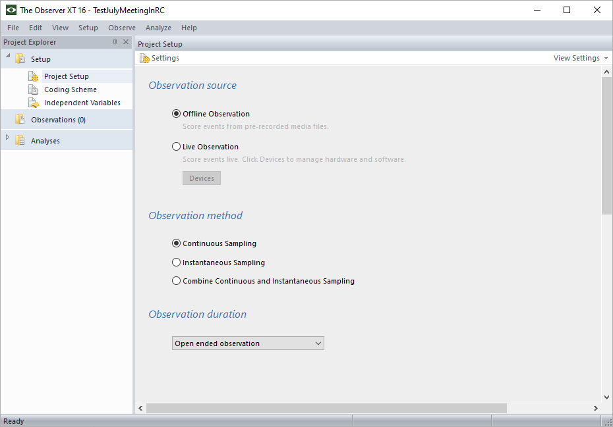
Choose Set up options
Choose to observe offline
Choose continuous sampling
Choose open-ended observation
Set Up 3/7​

Slide 20
In Setup, create your Coding Scheme
Add subjects
For single subjects, do not define them in the Coding scheme, identify them in the Independent Variables
For multiple subjects, enter their roles as subjects. For example, student, faculty, staff.
If you want to identify multiple subjects by name, do so in Independent Variables
Step 4/7​

Slide 21
In Setup, define Relevant Behaviors
Define behaviors and key codes you want to use to score their occurrence during your observation, add "other"
Can create behavior groups, if necessary
Behaviors with a duration are identified "State Events"
Behaviors without a duration are identified as "Point Events"
Set Up 5/7​

Slide 22
In Setup, two types of Behavior groups
Non-overlapping Behaviors
Mutually exclusive behavior group
Easiest to work with
Overlapping behaviors
Called a "Start-Stop," behavior group
More difficult to score
Can add text or numerical modifiers to specify behaviors more precisely – good for mean values
Set Up 6/7​

Slide 23
Adding Variables & Independent Variables
Independent Variables as defined remain constant (for example, participant ID – student, faculty)
Add and define Variables important to your study (for example, subject's perception of prior tech expertise)
See ObserverXT Help for more info
Email: info@noldus.nl
Set Up 7/7​

Slide 24
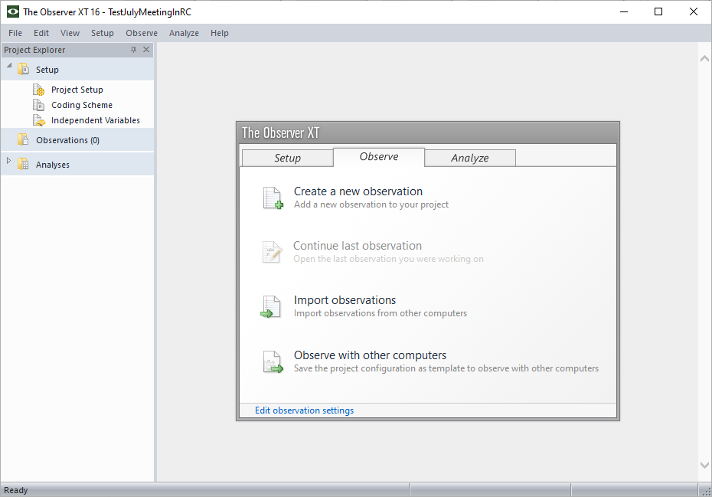
Step 2: Observe Acquiring your Data
Observe 1/3

Slide 25
Step 2: Observe Acquiring your Data
If you have already exported your file to ObserverXT, go directly to Observer XT and search for your file previously recorded and exported.
If you have not exported your file, but have saved it in Viso, go back and export it to ObserverXT
In ObserverXT, you also have the option of acquiring data through live observation and coding as you go along. This is more difficult and not recommended. (Observe >Observation >New)
Observe 2/3

Slide 26
Observe 3/3
If not doing live observation, open your previously-recorded, exported video file.
Code subjects as you see the behaviors you have coded in Set Up. At this point, don't use the behavior option.
Hit the spacebar to continue.
Step 2 Observe:
Acquiring
Your Data​
AAcAcquiring your Data
quiring your Data​

Slide 27
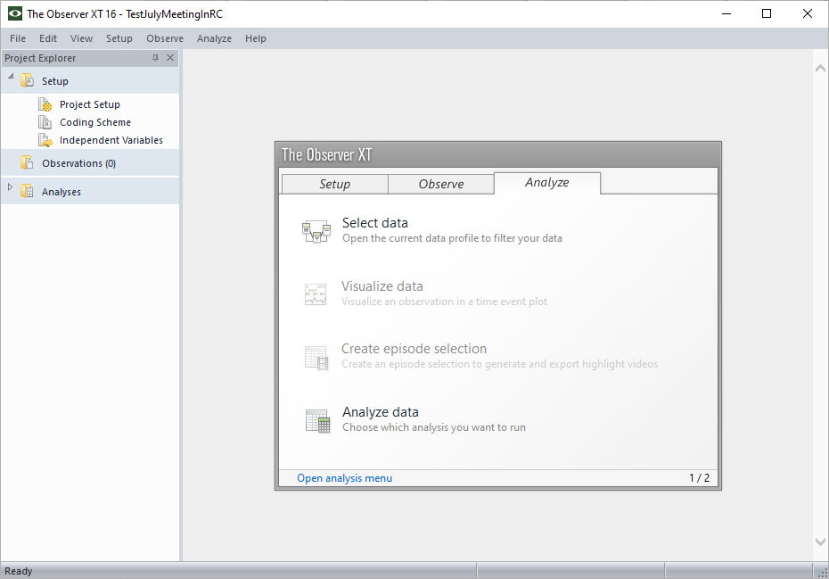
Step 3: Analyze
Analyze 1/2

Slide 28
Step 3: Analyze
Go to Episode Selections
Choose Analyze > Behavior Analysis > New >Statistics >Calculate
You may also analyze a selections of behaviors, subjects or observations and filter items as needed
For multiple observations, ObserverXT system can aggregate all data.
Analyze 2/2

Slide 29
Back up your Data
Choose File, Make Back up (saved at .vpb)
To reopen > choose File > Restore Backup
Open the .vpb file

